Slide 1
White House Tourism Improvement

Slide 2
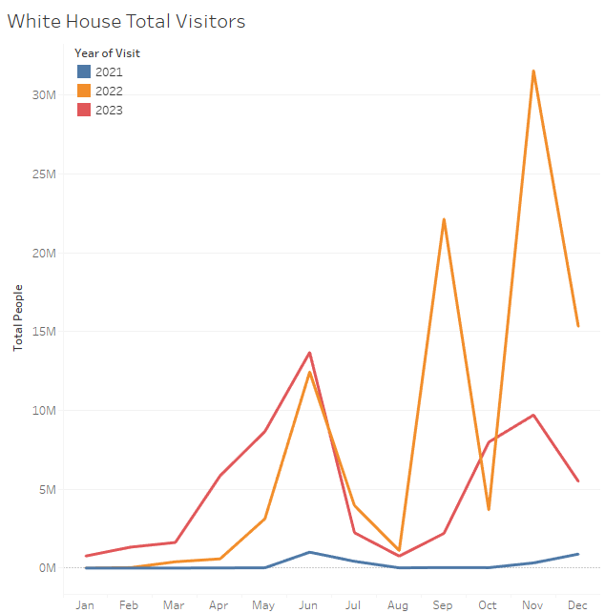
Yearly Visitors
Visitors have increased Year over Year
If this trend continues, we will need to hire more staff or look for alternatives

Slide 3
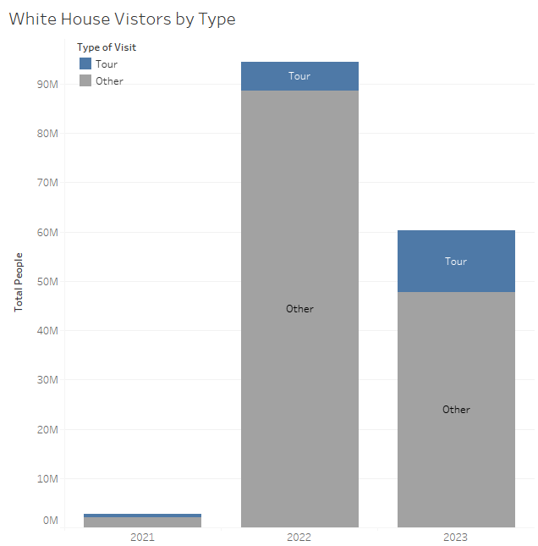
Tour Popularity
The vast majority are here on official business
We are seeing an increase in the numbers on the tours.

Slide 4
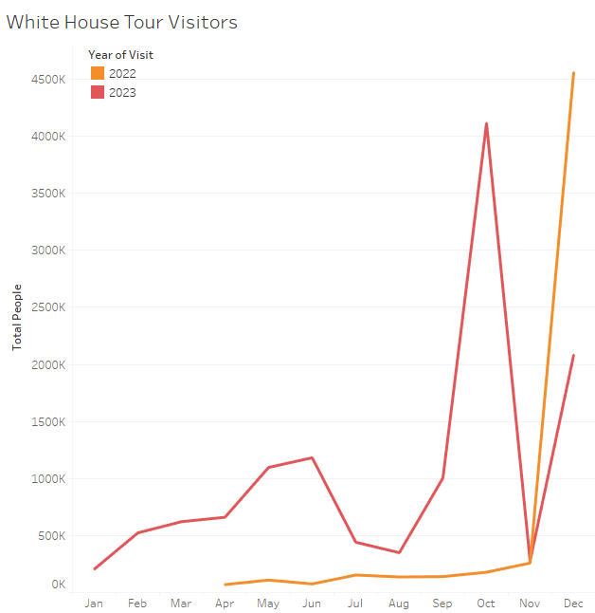
Monthly Tour Guests
The holiday season should have extra staff available.

Slide 5
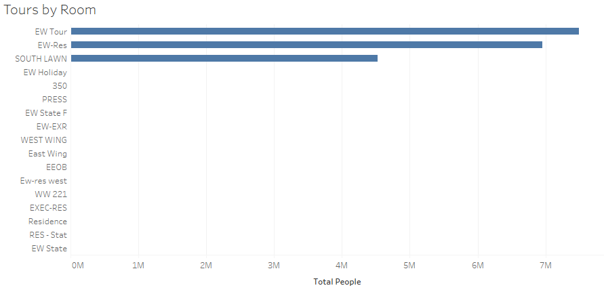
Tour Locations
The general Tour and the East Wing Tour are the most popular.

Slide 6
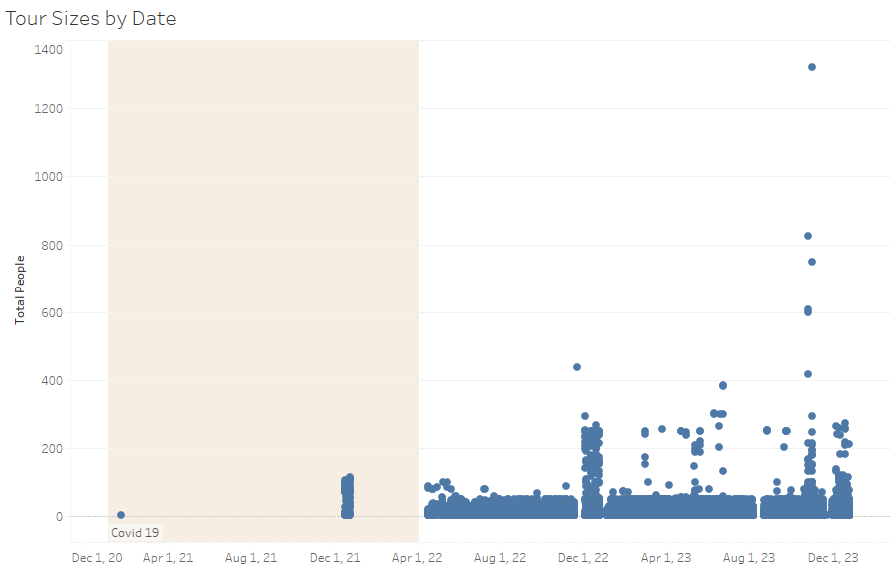
Tour Size
2021 visitors was impacted by Covid-19
Most of the tours are 50 or less

Slide 7
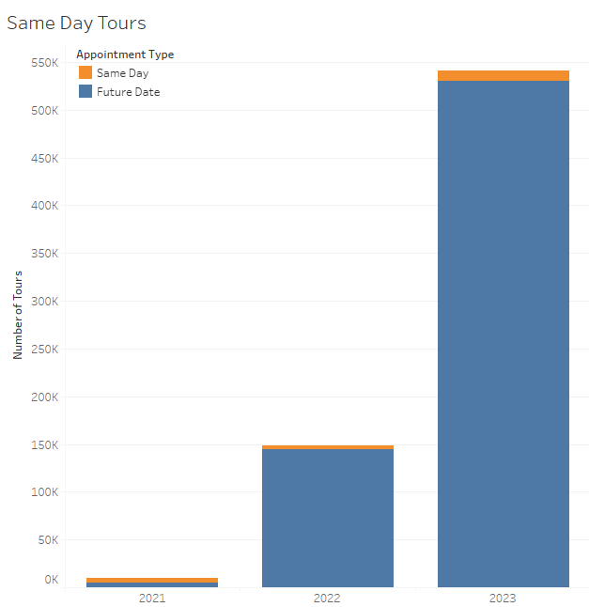
Same Day Tours
Same day tours could be increased by using VR

Slide 8
Proposed Solution
We should increase staffing through the year
We should create virtual tours during the slower times to allow more people to see and hear the tour.
Virtual Reality should be used to provide another method for visitors.
A less popular solution would be to increase the maximum size of the general tour groups above 50

